Slide 1
LF Wakeup Receiver AS3933
Oluf Alminde
19 January 2015

Slide 2

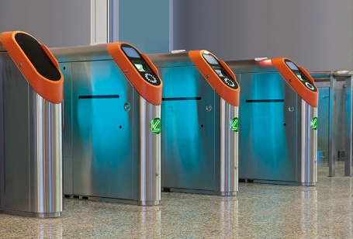

LF Wakeup Receiver
Markets & Applications
Active RFID tags
Container tracking
Real-time location systems in buildings
Persons
Valuable goods/equipment
Operator identification
Industrial machines
Various vehicles
Computers
Access control
Hospitals
handicapped
Elderly
Wireless sensor networks
Outdoor monitoring
Machine monitoring
Health monitoring

Slide 3
LF Wakeup Receiver
Overview
Device | Sensitivity | Frequency Range | Correlation Bits | Receiver Inputs | Antenna Tuning | Average Current Consumption
AS3930 | 100µV_{RMS} | 100 – 150 kHz | 16 bit | 1D | No | 2.7 µA
AS3932 | 100µV_{RMS} | 100 – 150 kHz | 16 bit | 3D | No | 2.7 µA
AS3933 | 80µV_{RMS} | 15 – 150 kHz | 32 bit | 3D | Yes | 2.7 µA
Best-in-class sensitivity
Lowest power consumptions
Widest frequency range

Slide 4
LF Wakeup Receiver
Typical system with wakeup
Host system and active tag with LF wakeup
UHF Transceiver with LF Wakeup Transmitter
Magnetic Coupling
Active Tag with AS3933
LF signal with wakeup pattern
Typical system with LF wakeup
The host system with a transceiver (typically UHF) includes a LF wakeup transmitter
The active tag includes the AS3933 wakeup receiver
Typical wakeup range is up to 10 meters
LF wakeup frequency is programmable from 15 kHz to 150 kHz

Slide 5
LF Wakeup Receiver
Typical active tag
Active Tag
AS3933
Wakeup Receiver
3D
ANTENNA
UHF Transceiver
Host
MCU
15 … 150 kHz
SPI
Typical active tag
Main function is to wake up the host system
The LF antenna coils consist of 3 axis (x/y/z)
AS3933 provides automatic antenna tuning

Slide 6
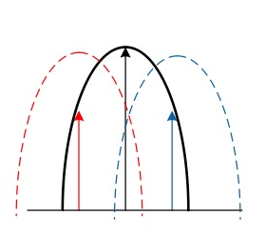
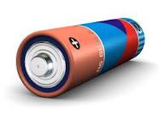
LF Wakeup Receiver
Key Features & Benefits
Automatic antenna tuning
Best performance of the solution
Simplifies antenna matching network
Best sensitivity in the industry
Maximum communication range
Allows usage of cheaper antenna coils
Widest frequency range
More flexibility
Allows usage of LF frequency outside the conventional range (125 and 134 kHz)
Less disturbers
32-bit pattern detection
Very resistant to false wakeup events
Reduces overall power consumption of the system

Slide 7
Thank you
Please visit our website www.ams.com

Slide 8
AS3933 – LF Wakeup Receiver
Key features
1, 2 or 3-channal ASK wake-up Rx
Frequency range: 15-150 kHz
Best in class wakeup sensitivity: 80µV_{RMS}
Automatic antenna tuning
Low current consumption: 2.7 µA
16- or 32-bit correlation
TSSOP16 & QFN16
Benefits
Wide frequency range allows for customization
High sensitivity = longer range, cheaper coils
Automatic antenna tuning alleviates miss-tuning
Low power consumption = extended battery life
Programmable capabilities = system flexibility
Applications
Active RFID tags
Real-time location systems
Wireless sensors
ID systems (operator, access control)
Asset tracking in harsh & wet applications

